Slide 1
Session 12
Random variables
Discrete random variables
Geometric
Poisson distributions

Slide 2
Random Process
Random processes, also known as stochastic processes, are used to model uncertain quantities that evolve in time.
The trajectory of a particle, the price of oil, the temperature in New York, the national debt of the United States, etc.

Slide 3
Random Variable
A random variable x takes on a defined set of values with different probabilities.
For example, if you roll a die, the outcome is random (not fixed) and there are 6 possible outcomes, each of which occur with probability one-sixth.
Roughly, probability is how frequently we expect different outcomes to occur if we repeat the experiment over and over

Slide 4
Python Code for Random Number
We can create a list of random numbers by repeatedly calling random().
import random
def random_list(n, secure=True):
random_floats = []
if secure:
crypto = random.SystemRandom()
random_float = crypto.random
else:
random_float = random.random
for _ in range(n):
random_floats.append(random_float())
return random_floats
print(random_list(10, secure=False))

Slide 5
Random variables can be discrete or continuous
Discrete random variables have a countable number of outcomes
Examples: Dead/alive, treatment/placebo, dice, counts, etc.
Continuous random variables have an infinite continuum of possible values.
Examples: blood pressure, weight, the speed of a car, the real numbers from 1 to 6.

Slide 6
Two Types of Random Variables
Discrete random variables
Number of sales
Number of calls
Shares of stock
People in line
Mistakes per page
Continuous random variables
Length
Depth
Volume
Time
Weight

Slide 7
Discrete Random Variable
The discrete random variables X and Y are said to be (stochastically)independent if, for all real numbers a and b,
P({X = a}∩{Y = b}) = P{X = a}•P{Y = b}
If X and Y are physically independent (e.g. repeated trials), then the above holds
But it is possible for the above equation to hold even though the random variables are provably physically dependent

Slide 8
Probability Distributions for Discrete Random Variables
The probability distribution of a discrete random variable is a graph, table or formula that specifies the probability associated with each possible outcome the random variable can assume.
p(x) ≥ 0 for all values of x
Σp(x) = 1

Slide 9
What is Probability Distribution Function?
A probability distribution is a function under probability theory and statistics- one that gives us how probable different outcomes are in an experiment.
The probability distribution function is the integral of the probability density function.
This function is very useful because it tells us about the probability of an event that will occur in a given interval
It describes events in terms of their probabilities; this is out of all possible outcomes.
Let’s take the probability distribution of a fair coin toss. Here, heads take a value of X=0.5 and tails gets X=0.5 too. Two classes of such a distribution are discrete and continuous. The former represented by a probability mass function and the latter by a probability density function.

Slide 10
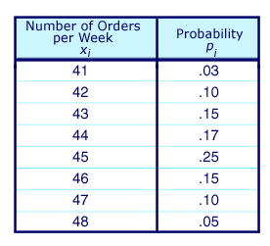
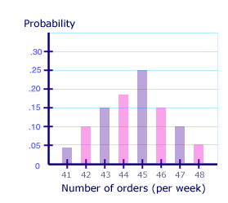
Example of Probability Distribution

Slide 11
Discrete Probability Distribution Function

Slide 12
Uniform Distribution
A type of probability distribution in which all outcomes are equally likely.
A coin also has a uniform distribution because the probability of getting either heads or tails in a coin toss is the same.
Two types of uniform distributions:
discrete and continuous. In the former type of distribution, each outcome is discrete.
In a continuous distribution, outcomes are continuous and infinite

Slide 13
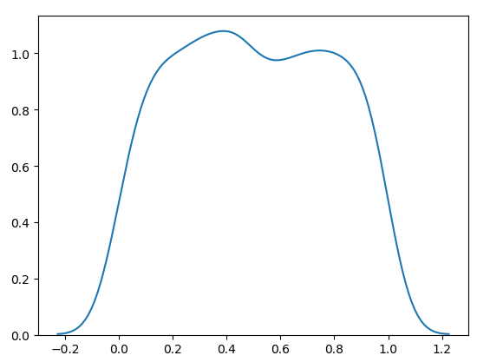
Example of Uniform Distribution
from numpy import random import matplotlib.pyplot as plt import seaborn as sns sns.distplot(random.uniform(size=1000), hist=False) plt.show()

Slide 14
Continuous Probability Distribution
Probability mass function for continuous data.
Central tendency, variation and skewness important parameters
Normal Probability Distribution
Lognormal Probability distribution.

Slide 15
Normal Distribution
Normal distribution, also known as the Gaussian distribution, is a probability distribution
It is symmetric about the mean, showing that data near the mean are more frequent in occurrence than data far from the mean.
In graph form, normal distribution will appear as a bell curve.

Slide 16
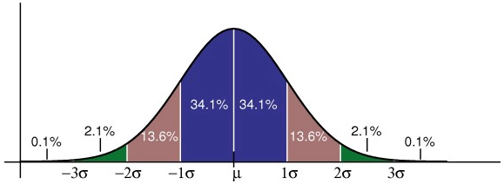
Properties of Normal Distribution
The mean, mode and median are all equal.
The curve is symmetric at the center (i.e. around the mean, μ).
Exactly half of the values are to the left of center and exactly half the values are to the right.
The total area under the curve is 1.

Slide 17
Normal Distribution(cont.)
A sample of outcomes from an experiment, a common first step is to plot the number of occurrences against sample values to get the distribution curve (histogram).
The resulting curve will expose the type of probability distribution your data follows .
Normal Distribution, it should look for a bell-shape curve.
If you see a rough estimation of a bell, you can proceed with other tests to be fully sure that your samples come from a normal distribution.

Slide 18
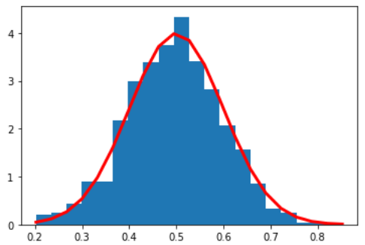
Example of Normal Distribution
import matplotlib.pyplot as plt
import numpy as np
mu, sigma = 0.5, 0.1
s = np.random.normal(mu, sigma, 1000)
# Create the bins and histogram
count, bins, ignored = plt.hist(s, 20, normed=True)
# Plot the distribution curve
plt.plot(bins, 1/(sigma * np.sqrt(2 * np.pi)) *
np.exp( - (bins - mu)**2 / (2 * sigma**2) ), linewidth=3, color='r')
plt.show()

Slide 19
How can you determine if your Probability Distribution is Normal?
Distribution tests are hypothesis tests that determine whether your sample data were drawn from a population that follows a hypothesized probability distribution.
Like any statistical hypothesis test, distribution tests have a null hypothesis and an alternative hypothesis.
H₀: The sample data follow the hypothesized distribution.
H₁: The sample data do not follow the hypothesized distribution.

Slide 20

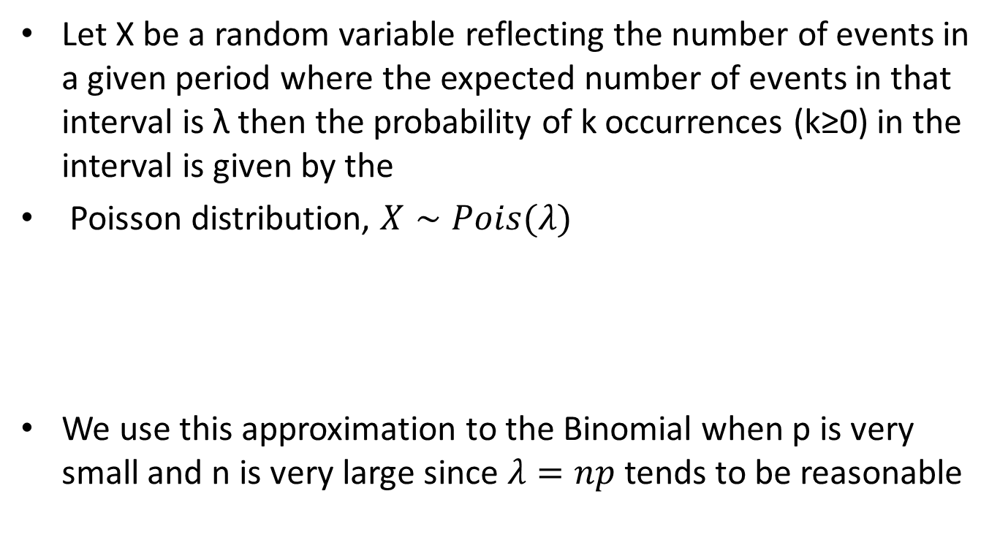
Poisson Distribution
Let X be a random variable reflecting the number of events in a given period where the expected number of events in that interval is λ then the probability of k occurrences (k≥0) in the interval is given by the
Poisson distribution, $X∼Pois(λ)$
We use this approximation to the Binomial when p is very small and n is very large since $λ=np$ tends to be reasonable

Slide 21
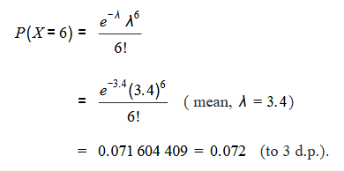
Example
If the random variable X follows a Poisson distribution with mean3.4, find P(X=6)
Solution: This can be written more quickly as: if X~Po(3.4) find P(X=6)

Slide 22

Example
Suppose there is a disease, whose average incidence is 2 per million people. What is the probability that a city of 1 million people has at least twice the average incidence? Twice the average incidence would be 4 cases.
We can reasonably suppose the random variable X=number of cases in 1 million people has Poisson distribution with parameter.

Slide 23
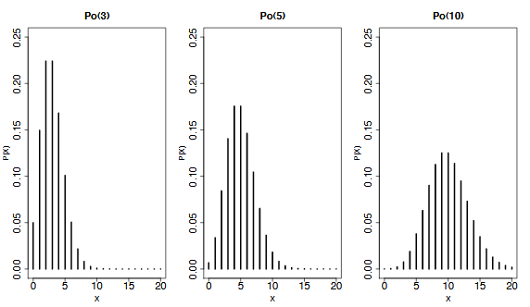
Example

Slide 24
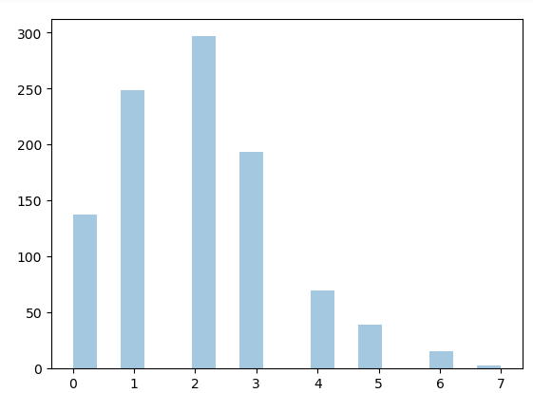
Python code for Poisson Distribution
from numpy import random import matplotlib.pyplot as plt import seaborn as sns sns.distplot(random.poisson(lam=2, size=1000), kde=False) plt.show()

Slide 25

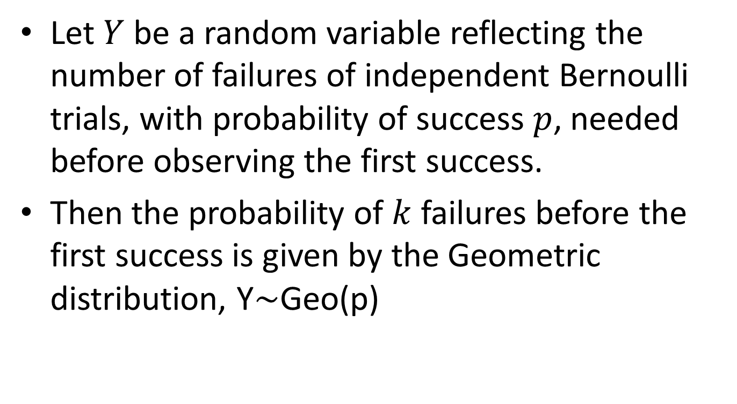
Geometric Distribution
Let $Y$ be a random variable reflecting the number of failures of independent Bernoulli trials, with probability of success $p$, needed before observing the first success.
Then the probability of $k$ failures before the first success is given by the Geometric distribution, Y∼Geo(p)

